Slide 1
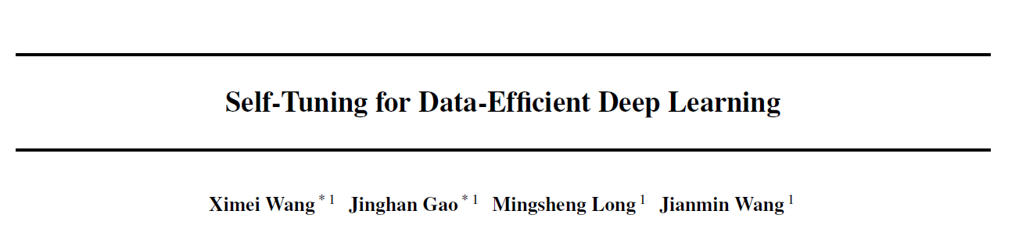
How to mitigate the requirement for labeled data?
Speaker: Xiujie Song
the 38 th International Conference on Machine Learning, PMLR 139, 2021.

Slide 2
Outline
Introduction
Preliminaries
Self-Tuning
Experiments
Conclusion

Slide 3

Introduction: background
Background: Huge amount of data.
Problem: It is time-costly and labor-expensive to collect sufficient labeled data in most realistic scenarios through manual labeling.
How to mitigate the requirement for labeled data?
Solution:
Semi-supervised learning (SSL)
Transfer Learning (TL)

Slide 4
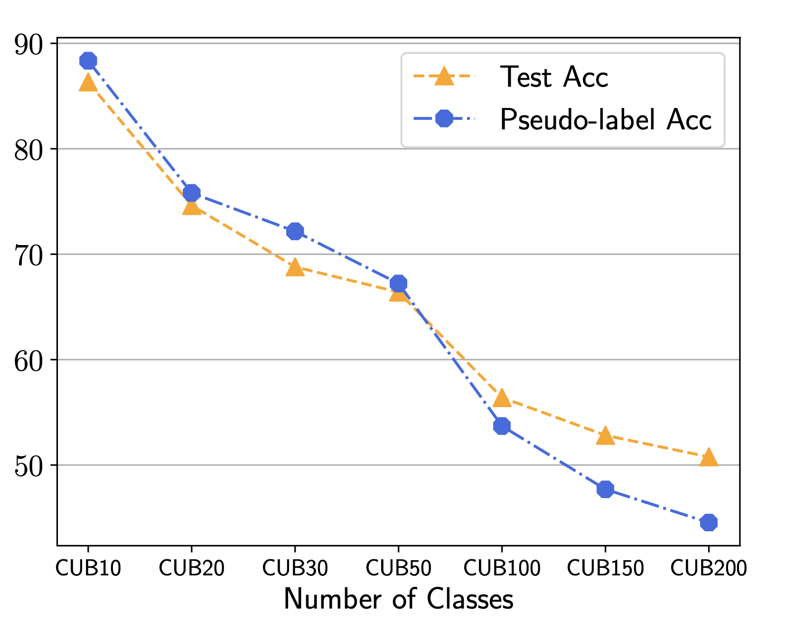
Introduction: Semi-supervised Learning
Self-training in SSL:
Acc of FixMatch on CUB
pseudo-
labeling
Labeled data set.
Unlabeled data set.
Labeled data set.
(with pseudo labels)
train
train
Model
(teacher)
train
Model
(student)
inference
An obvious obstacle!
Confirmation bias: the performance of a student is restricted by the teacher when learning from inaccurate pseudo-labels.

Slide 5
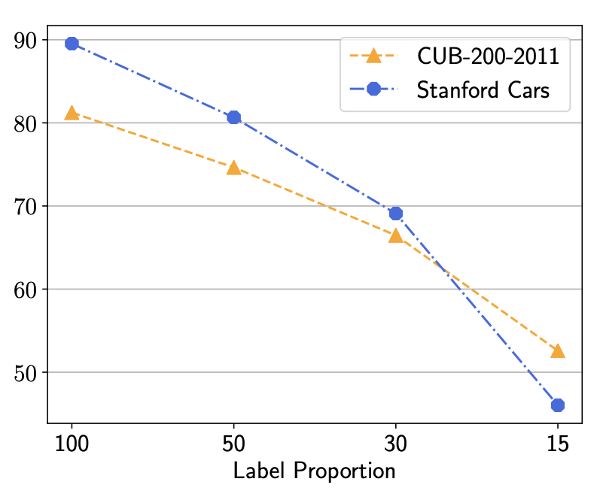
Introduction: Transfer Learning
Test acc. of co-tuning
Model 1
Data set 1
Predictions 1
Knowledge transfer
Model 1
Predictions 2
Data set 2
Label proportion: the proportion of labeled data set.
Model shift: without exploring the intrinsic structure of un-labeled data, the fine-tuned model shifts towards the limited labeled data after leaving away from the original smooth model pre-trained on a large-scale dataset, causing an unsatisfactory test accuracy on the target dataset.

Slide 6

Introduction
a). Which problem is caused by inaccurate pseudo labels?
A. Confirmation bias
B. Model shift
b). Model shift is the problem of which method?
A. Transfer learning
B. Semi-supervised learning

Slide 7
Outline
Introduction
Preliminaries
Self-tuning
Experiments
Conclusion

Slide 8
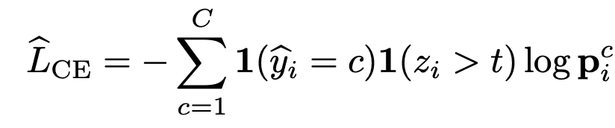
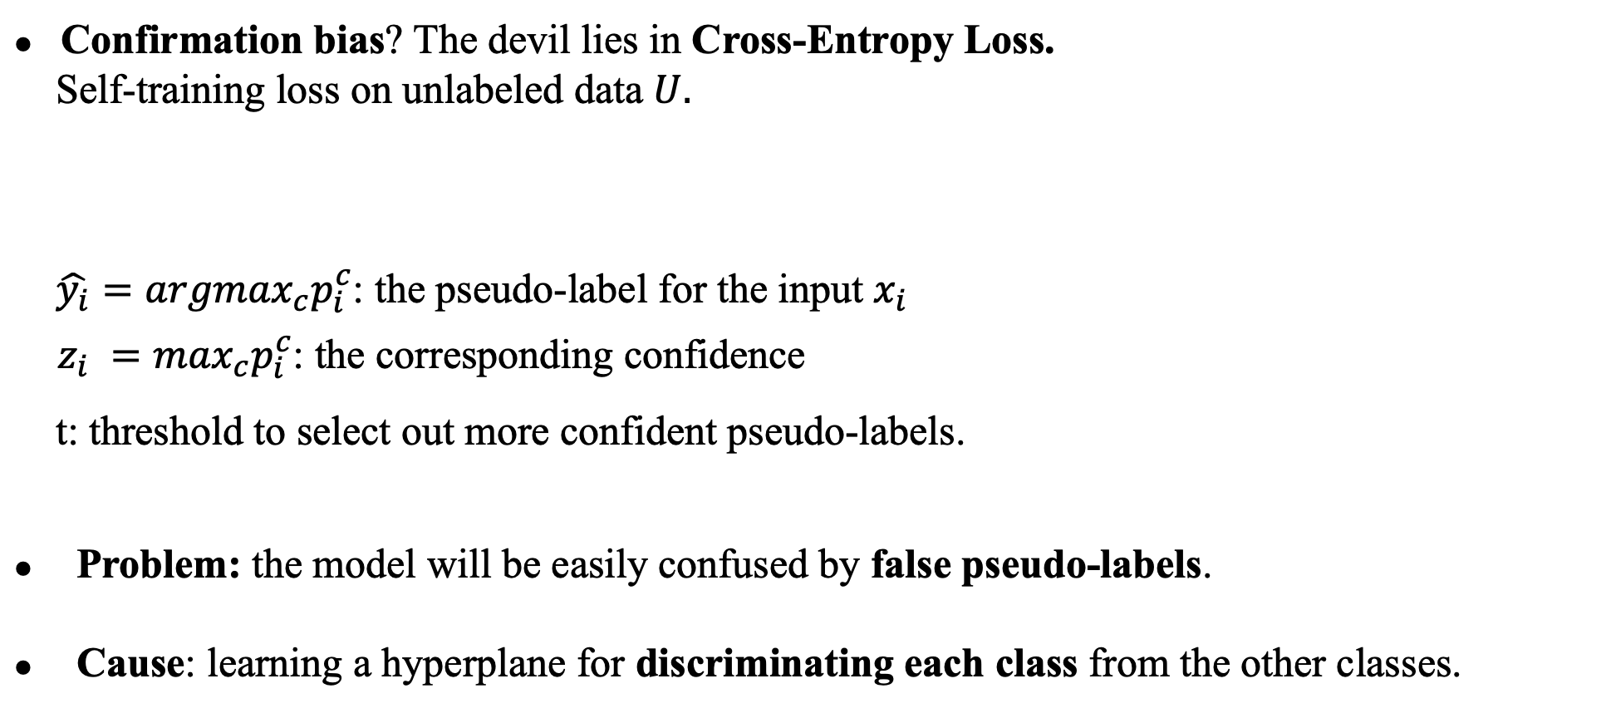
Preliminaries
Confirmation bias? The devil lies in Cross-Entropy Loss.
Self-training loss on unlabeled data $U.$
$\hat{y_{i}}={argmax}_{c}p_{i}^{c}$: the pseudo-label for the input $x_{i}$
$z_{i} =\max_{c}p_{i}^{c}$: the corresponding confidence
t: threshold to select out more confident pseudo-labels.
Problem: the model will be easily confused by false pseudo-labels.
Cause: learning a hyperplane for discriminating each class from the other classes.

Slide 9
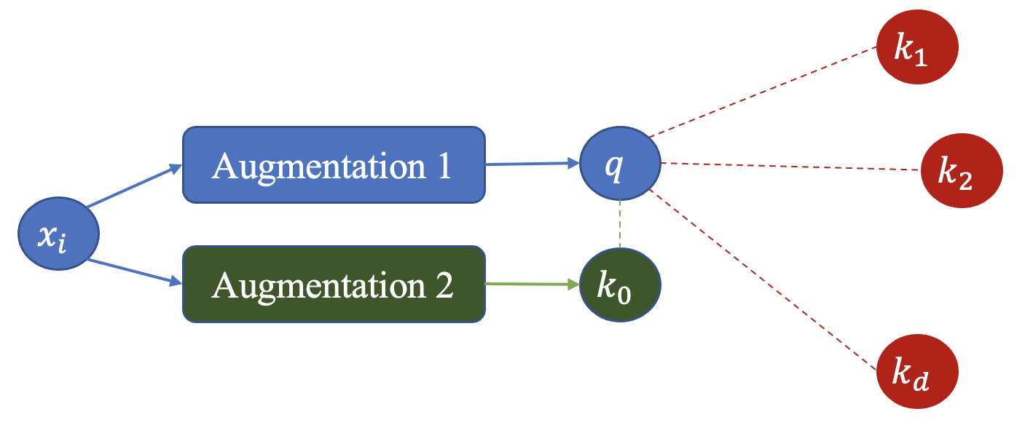
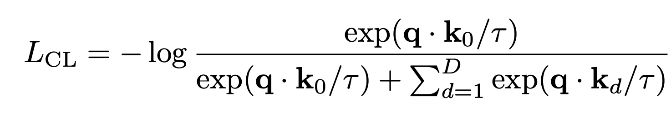
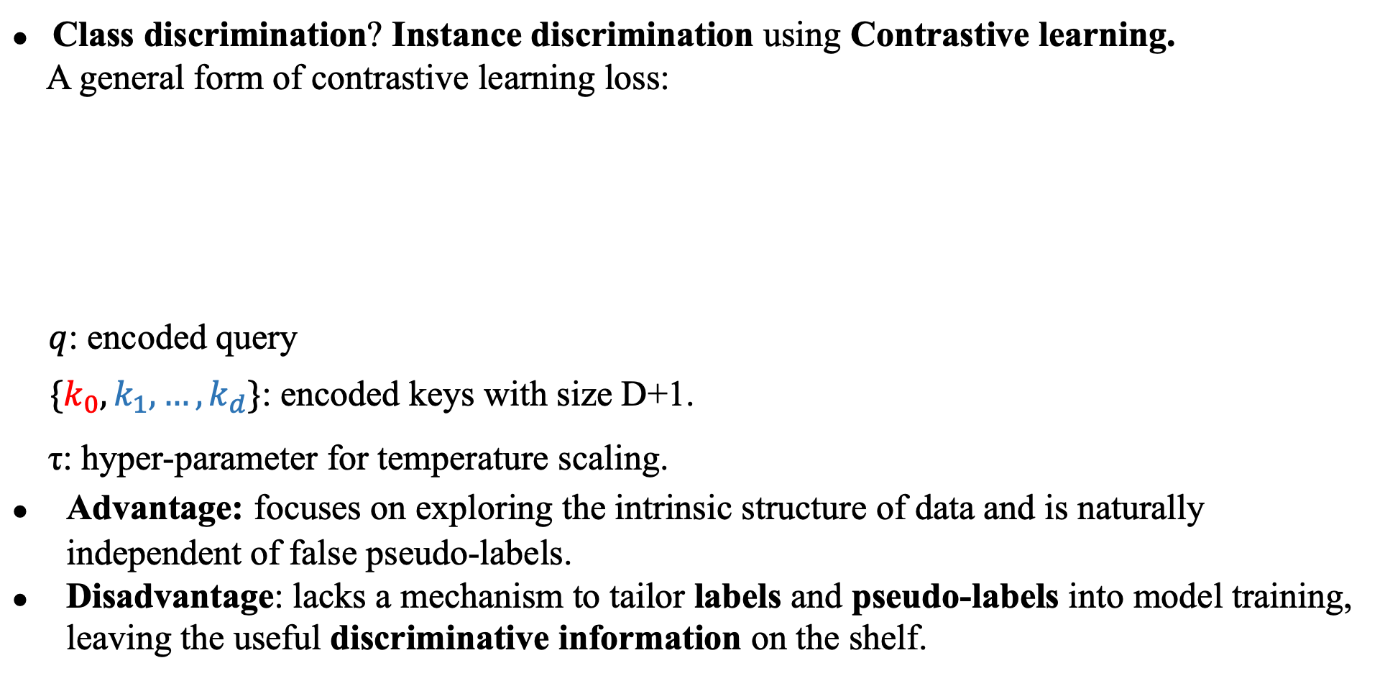
Preliminaries
Class discrimination? Instance discrimination using Contrastive learning.
A general form of contrastive learning loss:
$q$: encoded query
${\{k}_{0},k_{1},…,k_{d}\}$: encoded keys with size D+1.
τ: hyper-parameter for temperature scaling.
Advantage: focuses on exploring the intrinsic structure of data and is naturally independent of false pseudo-labels.
Disadvantage: lacks a mechanism to tailor labels and pseudo-labels into model training, leaving the useful discriminative information on the shelf.

Slide 10
Outline
Introduction
Preliminaries
Self-tuning
Experiments
Conclusion

Slide 11


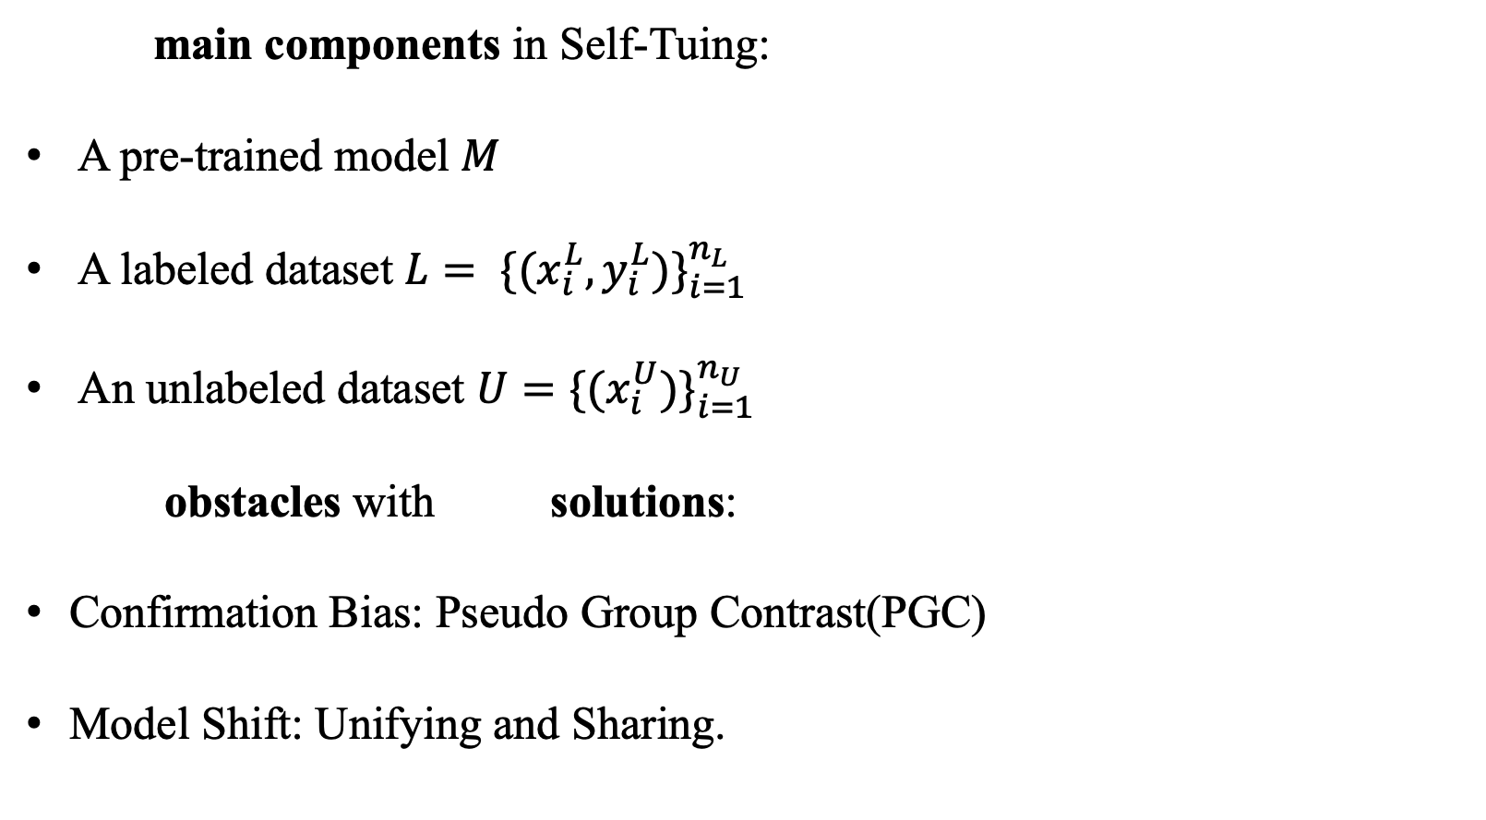
Self-Tuning
main components in Self-Tuing:
A pre-trained model $M$
A labeled dataset ${L= \{(x_{i}^{L},y_{i}^{L})\}}_{i=1}^{n_{L}}$
An unlabeled dataset $U={\{(x_{i}^{U})\}}_{i=1}^{n_{U}}$
obstacles with solutions:
Confirmation Bias: Pseudo Group Contrast(PGC)
Model Shift: Unifying and Sharing.

Slide 12
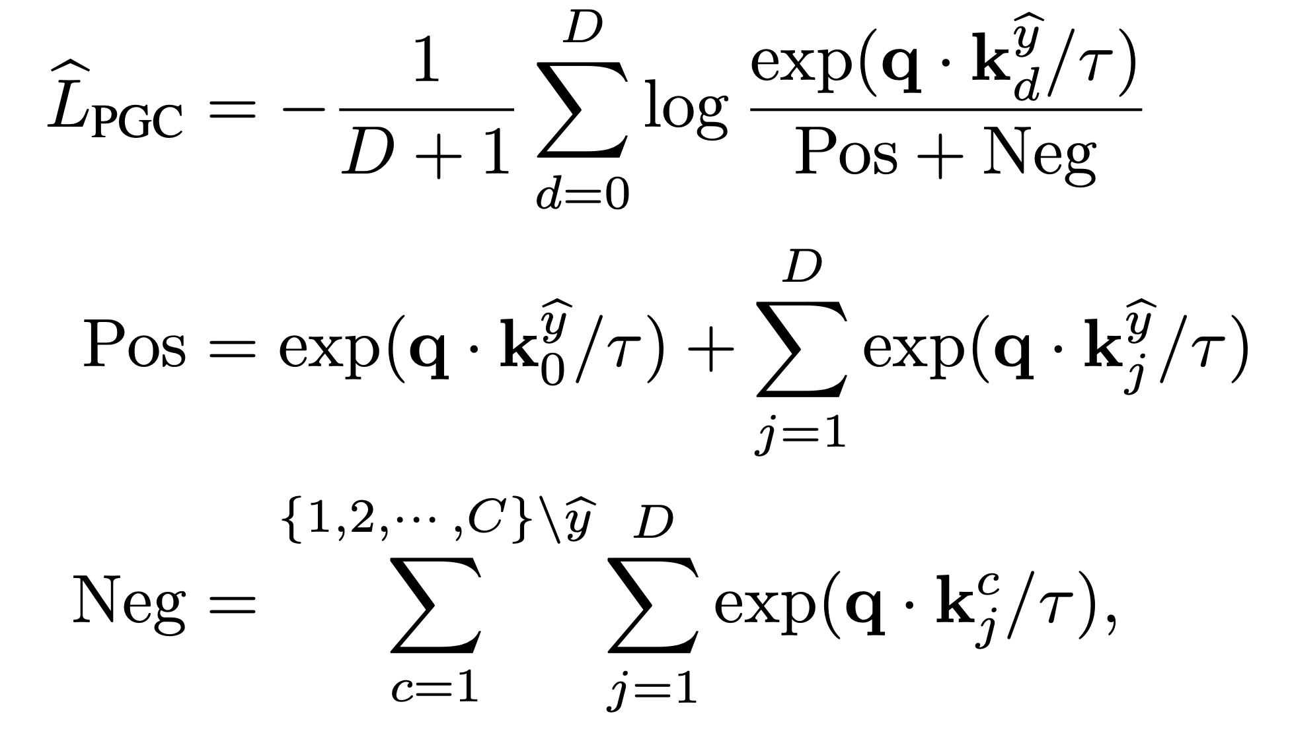
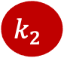




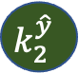






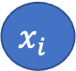


Self-Tuning: Pseudo Group Contrast for Confirmation Bias
$$k_{1}$$
standard CL:
Augmentation 1
$$q$$
$$k_{2}$$
$$x_{i}$$
Augmentation 2
$$k_{0}$$
$$k_{d}$$
PGC:
$$k_{j}^{c_{1}}$$
$$k_{2}^{\hat{y}}$$
$$k_{1}^{\hat{y}}$$
Augmentation 1
$$q_{ }^{\hat{y}}$$
$$k_{d}^{\hat{y}}$$
$$k_{j}^{c_{2}}$$
$$x_{i}^{\hat{y}}$$
Augmentation 2
$$k_{0}^{\hat{y}}$$
$$k_{j}^{c_{n}}$$

Slide 13






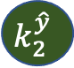


Self-Tuning: Pseudo Group Contrast for Confirmation Bias
PGC:
$$k_{j}^{c_{1}}$$
$$k_{2}^{\hat{y}}$$
$$k_{1}^{\hat{y}}$$
Augmentation 1
$$q$$
$$k_{d}^{\hat{y}}$$
$$k_{j}^{c_{2}}$$
$$x_{i}^{\hat{y}}$$
Augmentation 2
$$k_{0}^{\hat{y}}$$
$$k_{j}^{c_{n}}$$
Advantage:
Compared with traditional contrastive learning: make use of pseudo labels.
Compared with CE loss: mitigate the reliance on pseudo labels and boost tolerance to false labels.

Slide 14
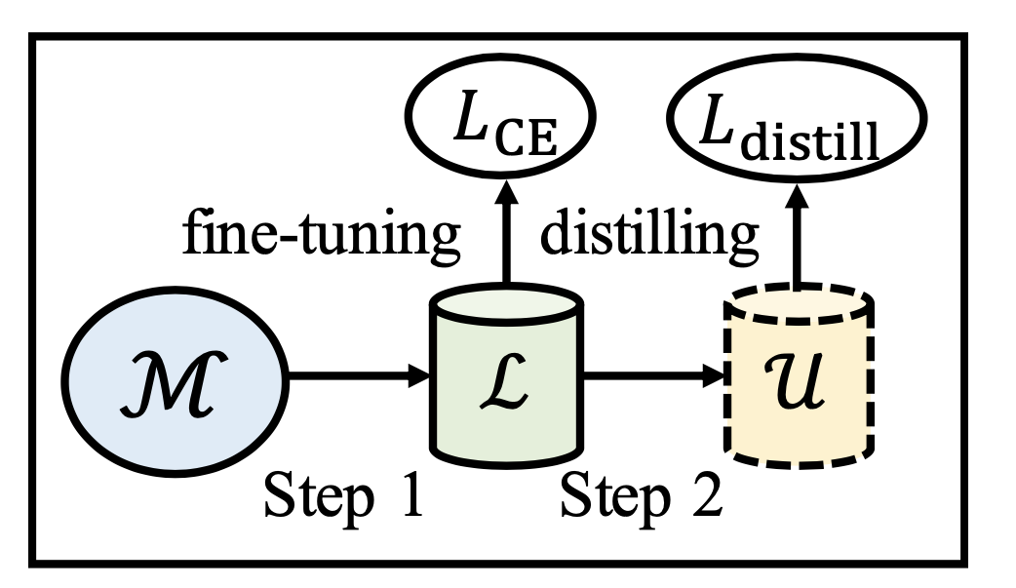
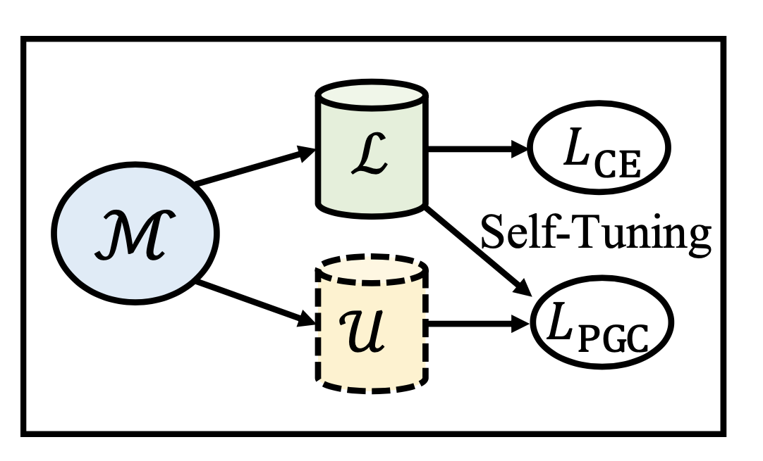
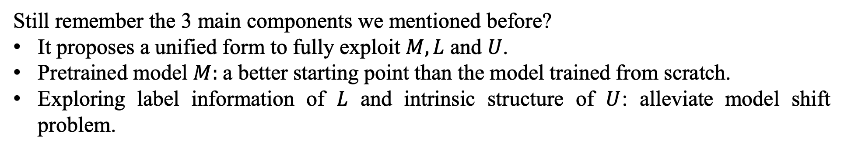
Self-Tuning: Unifying and Sharing for Model Shift
Still remember the 3 main components we mentioned before?
It proposes a unified form to fully exploit $M, L$ and $U$.
Pretrained model $M$: a better starting point than the model trained from scratch.
Exploring label information of $L$ and intrinsic structure of $U$: alleviate model shift problem.
SimCLRv2
Self-Tunig

Slide 15
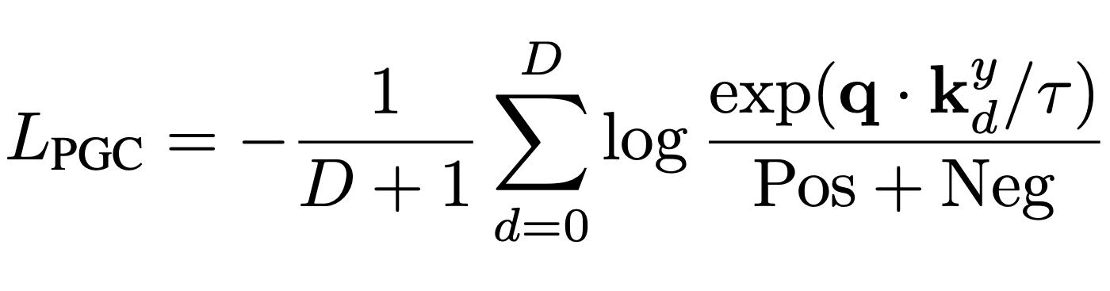
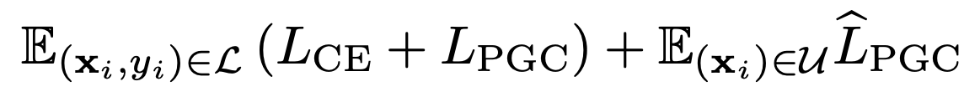
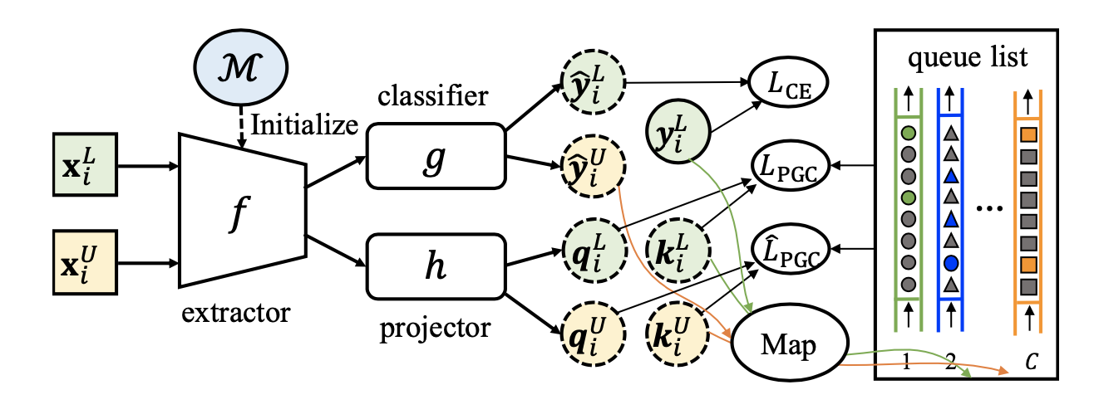
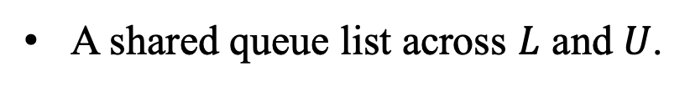
Self-Tuning: Overall Architecture
A shared queue list across $L$ and $U$.
Ground-truth version of PGC.
Overall loss of self-tuning.
The “Map” denotes a mapping function which assigns a newly-generated key to the corresoping queue according to its label or pseudo-label.

Slide 16
Outline
Introduction
Preliminaries
Self-tuning
Experiments
Conclusion

Slide 17
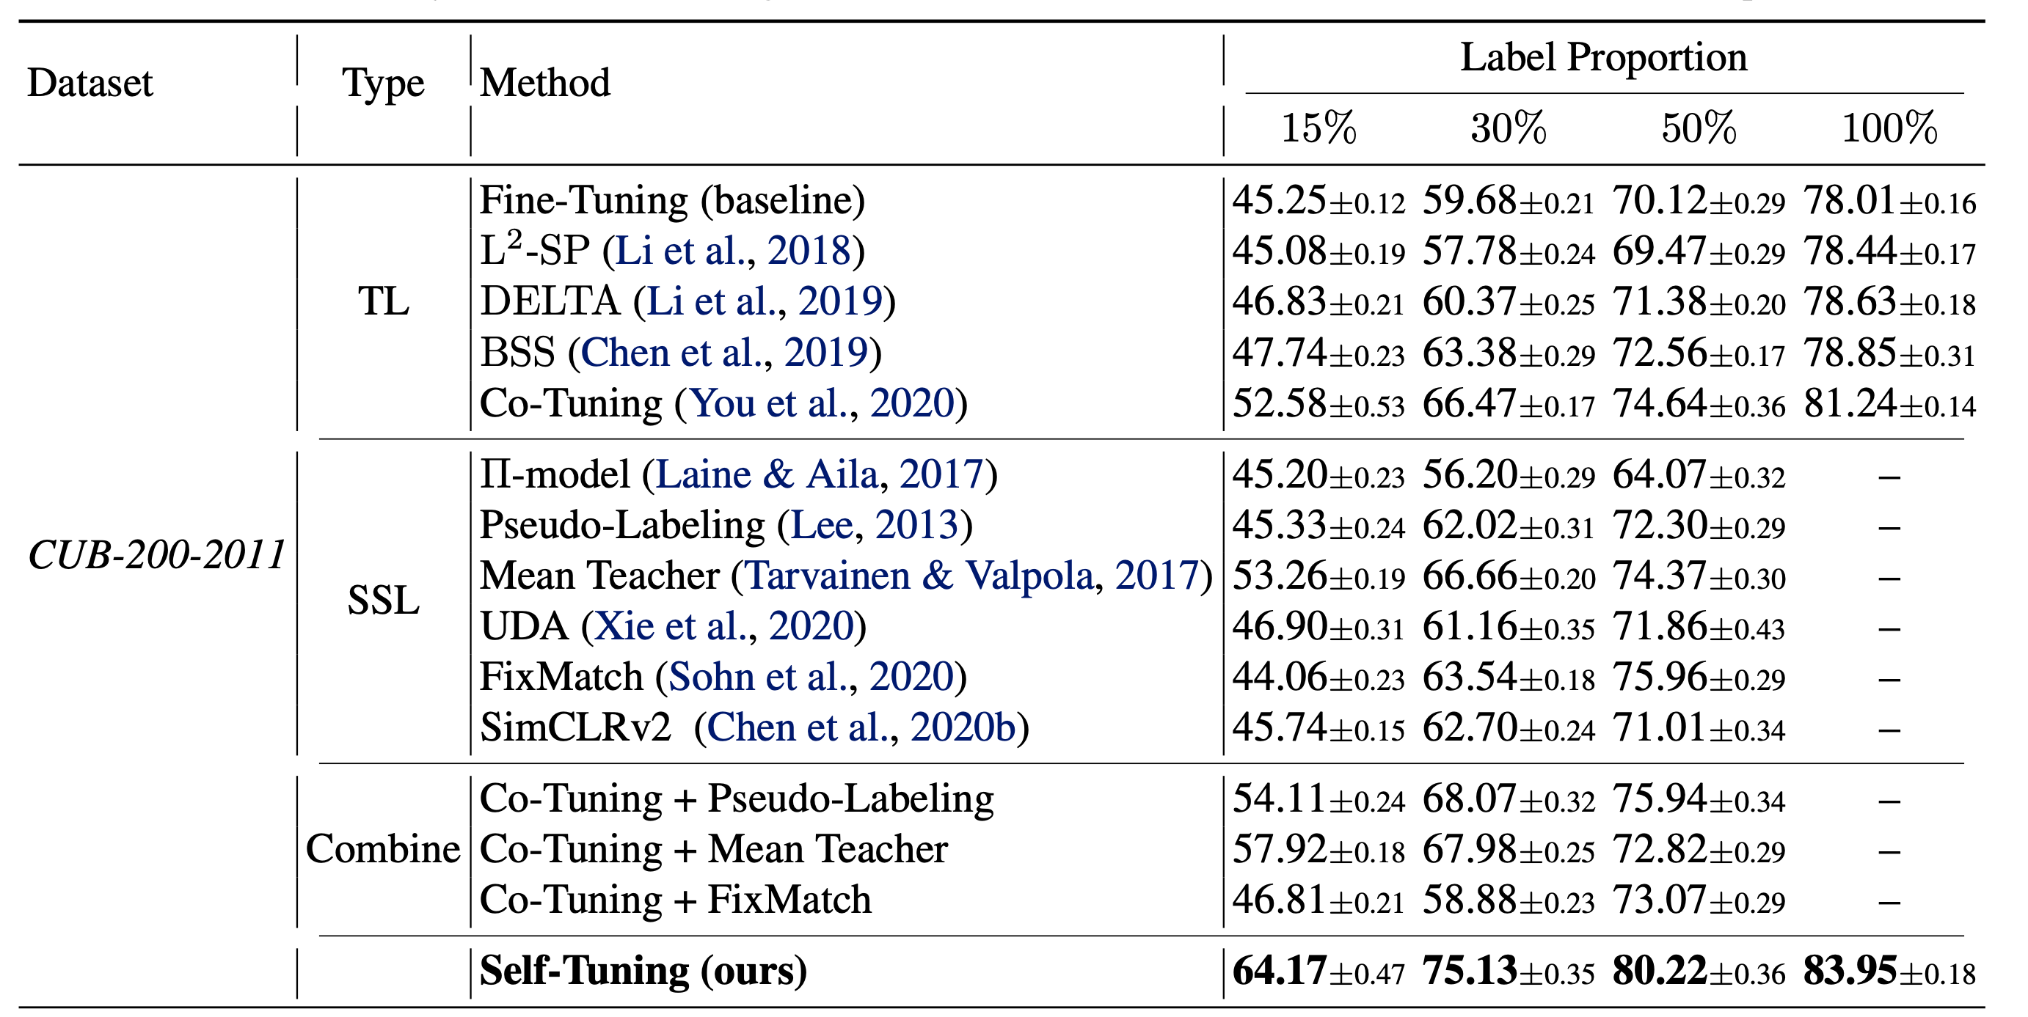
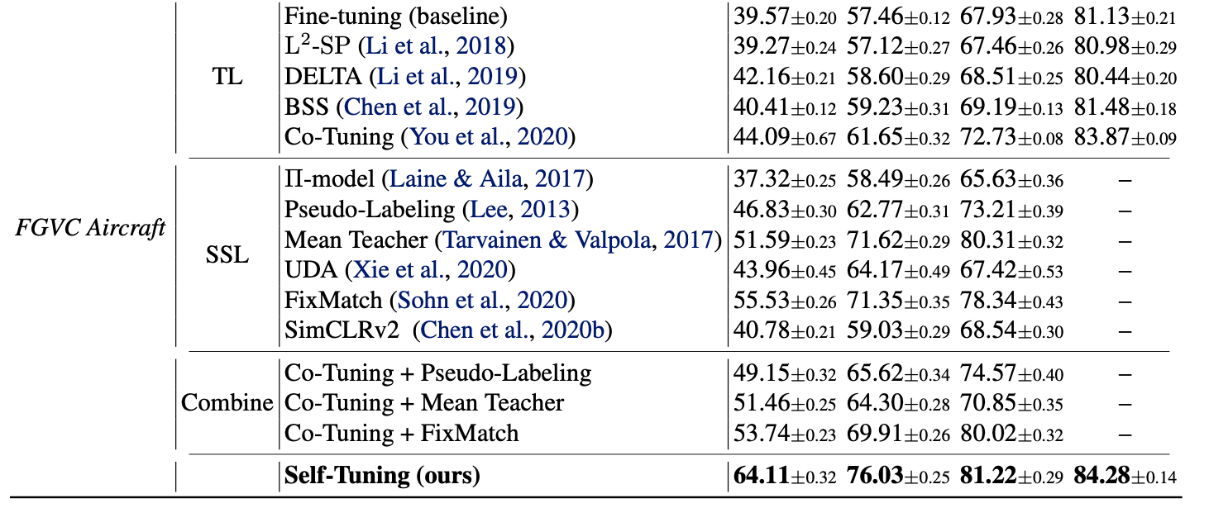
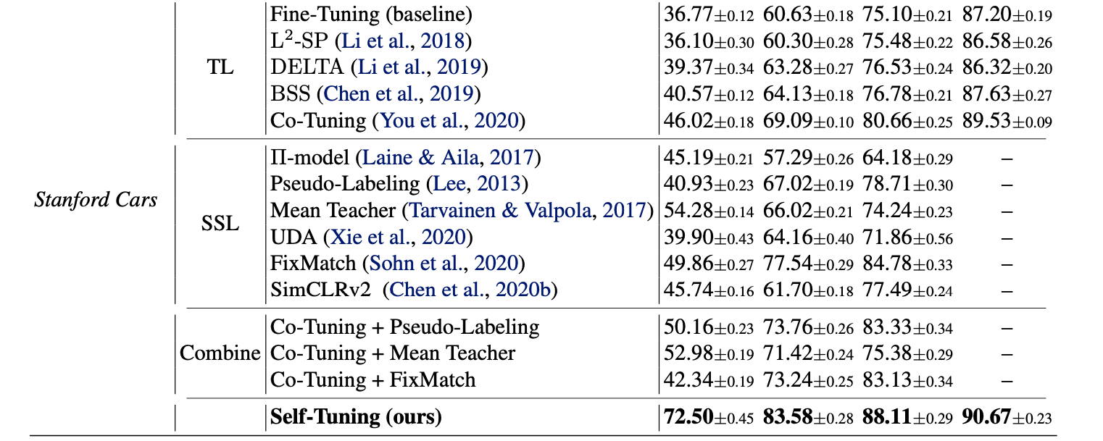
Experiments: TL benchmarks
Classification accuracy (%) ↑ of Self-Tuning and various baselines on standard TL benchmarks (ResNet-50 pre-trained).
Conclusion:
Neither a simple combination of SSL and TL methods nor a sequential form between labeled and unlabeled data (SimCLRv2) achieve satisfactory performance.
Self-Tuning outperforms its SSL and TL counterparts by sharp margins.
With only a half of labeled data, Self-Tuning surpasses the fine-tuning method with full labels.
If the target dataset is fully labeled, Self-Tuning seamlessly boils down to a competitive transfer learning method.
Label proportion: the proportion of labeled data set.

Slide 18
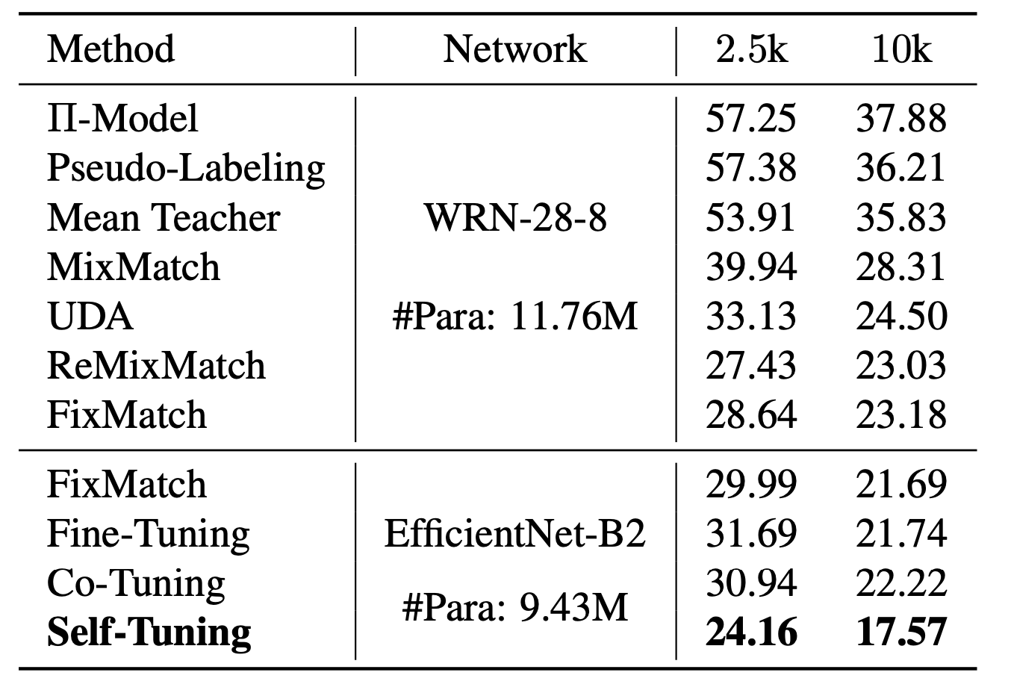
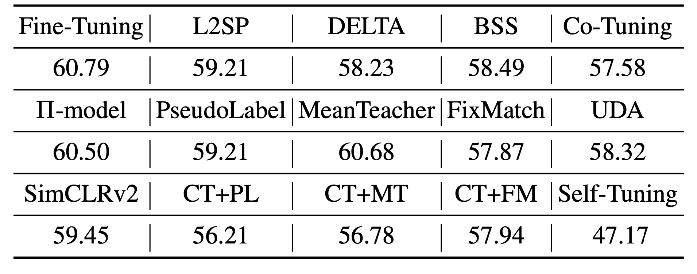
Experiments: SSL benchmark
Error rates (%) ↓ on standard SSL benchmark: CIFAR-100 provided with only 400 labels, 2500 labels and 10000 labels.
Error rates (%) ↓ on CIFAR-100 provided with only 400 labels and a pre-trained EfficientNet-B2 model (CT: Co-Tuning; PL: PseudoLabel; MT: MeanTeacher; FM: FixMatch.)

Slide 19
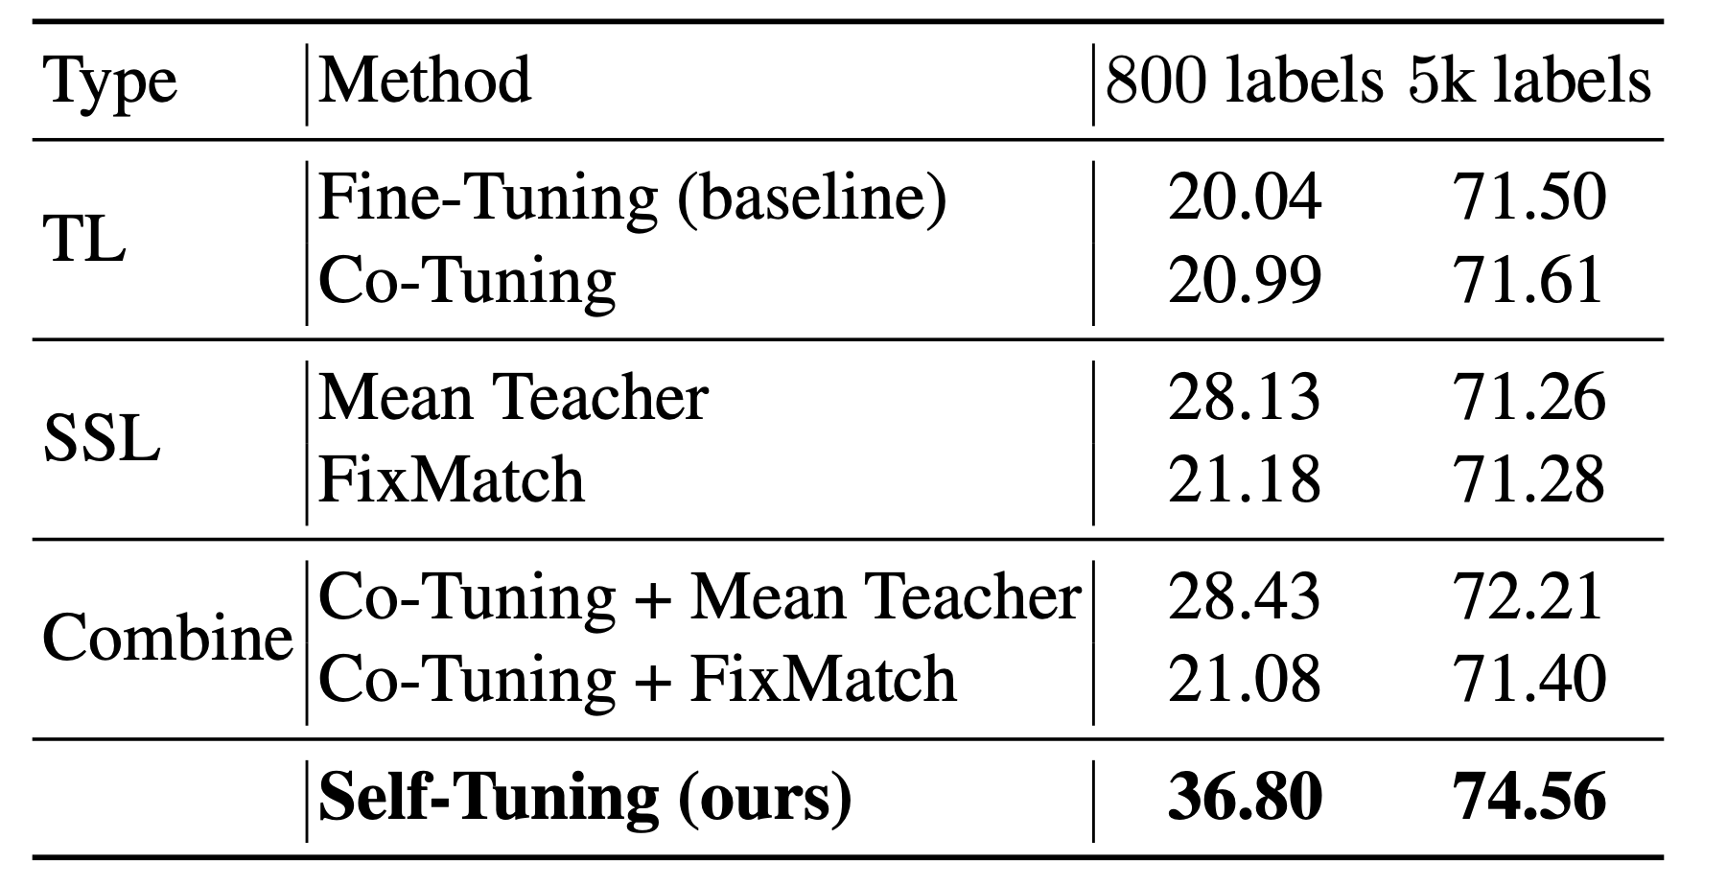
Experiments: unsupervised pre-trained model
Classification accuracy (%) ↑ with a typical unsupervised pre-trained model MoCov2 on CUB-200-2011.
Conclusion:
Self-Tuning is not bound to specific pretrained pretext tasks.
Self-Tuning also achieves a new state-of-the-art of 94.53 on CoNLL 2003 using BERT.

Slide 20
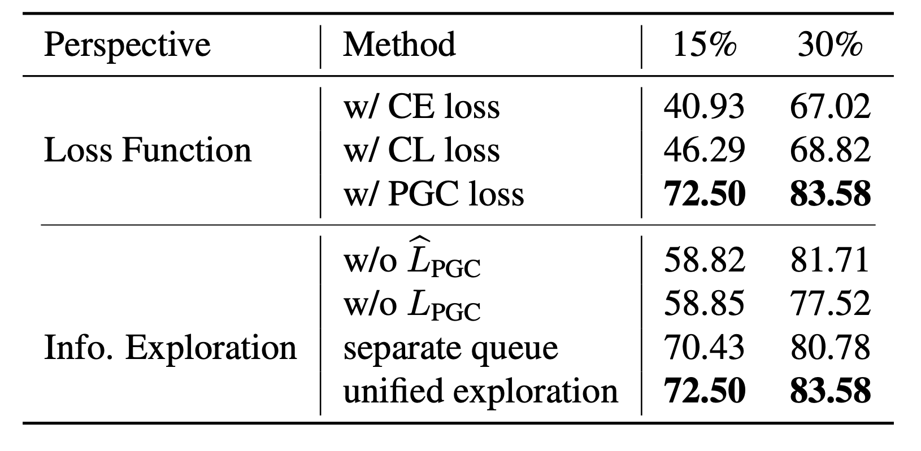
Experiments: ablation study
Ablation studies of Self-Tuning on Stanford Cars.
Conclusion:
PGC loss is much better than CE loss and CL loss for data-efficient deep learning.
Unified exploration is the best choice.

Slide 21
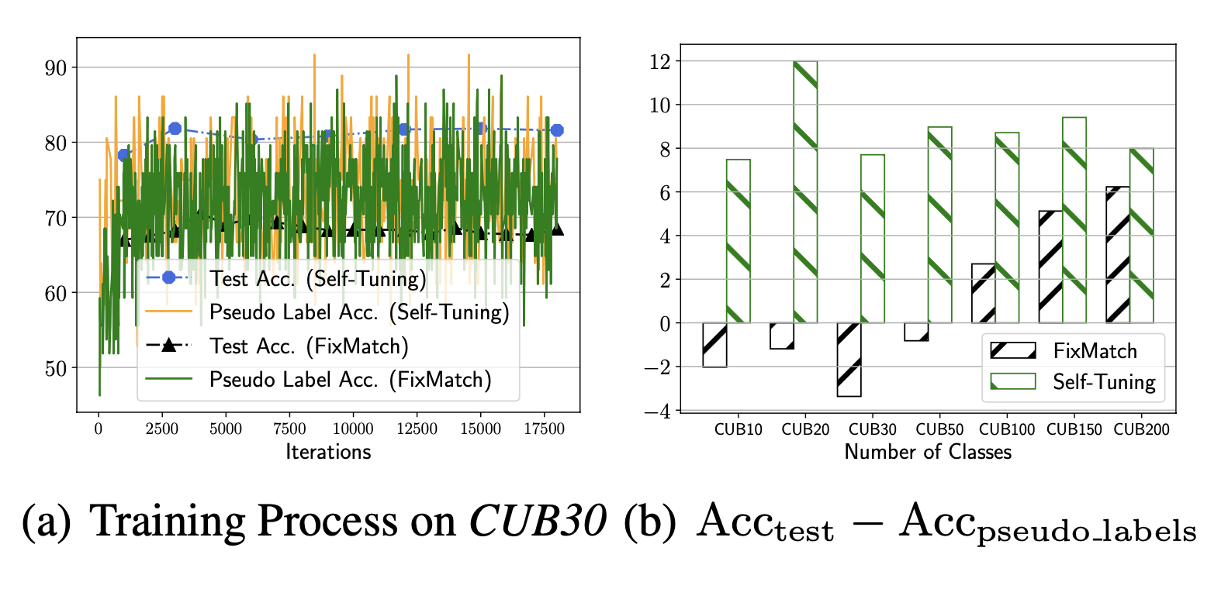
Experiments: why self-tuning works?
Comparisons between Self-Tuning with FixMatch on pseudo label accuracy and test accuracy.
Conclusion:
PGC mechanism successfully boosts the tolerance to false labels.

Slide 22
Outline
Introduction
Preliminaries
Self-tuning
Experiments
Conclusion

Slide 23
Conclusion
Advantage:
Mitigate the requirement for labeled data by unleashing the power of pretrained model, labeled data set and unlabeled data set.
To address the challenge of confirmation bias, PGC is devised to mitigate the reliance on pseudo labels and boost the tolerance of false labels.
To tackle the model shift problem, it unifies the exploration of labeled and unlabeled data and the transfer of a pre-trained model, with a shared key queue.
Disadvantage:
How to analyze PGC’s power of fault tolerance quantitatively remains a problem.

Slide 24
Thanks ☺, any questions?

